Slide 1
Contents:
Introduction
Problem statement
Solution
Objectives
Literature survey
Application of inventory management

Slide 2
Introduction:
Inventory is a physical resource that a firm holds in stock with the intent of selling it or transforming it into a more valuable state.
Inventory management is a step in the supply chain where inventory and stock quantities are tracked in and out of your warehouse.
An inventory management system is a tool that allows you to track goods across your business's supply chain. It optimizes the entire spectrum spanning from order placement with your vendor to order delivery to your customer, mapping the complete journey of a product.
Smart Inventory Management System is an online software application which fulfills the requirement of a typical Stock Analysis in various go downs.

Slide 3
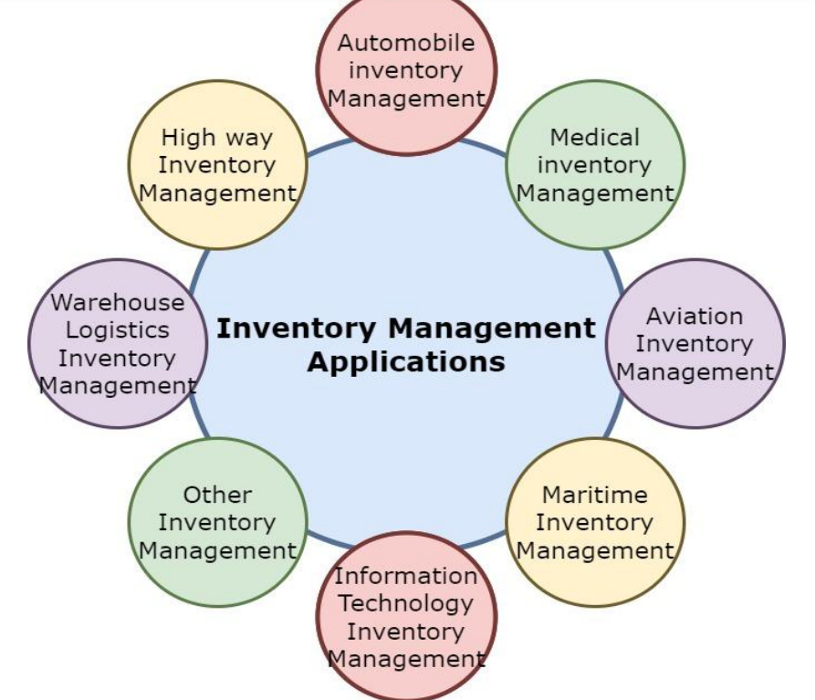
Applications of Inventory Management

Slide 4
Problem statement:
Inventory management is one of the basic problems for a company .it may cause a lot of paperwork , if there is no automated system available.
The process of manually looking for the inventory available in stock is really time consuming and cumbersome that includes the person responsible to see how many materials are in the inventory , how many materials have been ordered and received and keep the record of the time that will take for the suppliers to process orders and other various tasks included in inventory .

Slide 5
Solutions
Inventory management software
Standardize inventory processes
Regular inventory audits:
Mobile Inventory Management Apps
Barcode Scanners and Inventory Management Software:

Slide 6
OBJECTIVES
Implement real-time inventory tracking to ensure precise data on stock levels across all locations.
Automate manual inventory processes like receiving, picking, and shipping to enhance accuracy and speed.
To keep material cost under control as they contribute to reducing the cost of production
To eliminate duplication in ordering stocks.
To supply the required material continuously
To maintain the availability of materials whenever and wherever required in enough quantity
To avoid both overstocking and under-stocking of inventory.

Slide 7
Literature Survey
Title of the work: “Inventory Management System”
Authors: Shreyas Borwankar *1
Description:This рарer hаs рresented аn inventоry mаnаgement system, the dаtаbаse needs tо be uрdаted every dаy оr befоre inventоries sо thаt new eligible dаtа mаy be enrоlled аnd thоse whо аre useless аre remоved frоm the dаtаbаse

Slide 8
Literature Survey
Title of the work: “Design and Implementation of Inventory Management System for University”
Authors: Santosh Soni, Pankaj Chandra, Akanksha Gupta, Deepak Kant Netam, Sushant Kumar, Kaushik Tiwary
Description: This paper aims to develop a web-based application project for the finance department of a college using HTML, Bootstrap, CSS, JavaScript, PHP, Ajax, and SQL

Slide 9
Literature Survey
Title of the work: “Inventory Management System”
Authors: Ankitha Venkatesh1 , Kiran Kumar M N2
Description: an inventory management system is a crucial tool for businesses to track, organize, and control their inventory effectively

Slide 10
Technology used :
Programming Language:
PHP
Database:
MySQL
PHP Frameworks:
Laravel
Web Server:
Apache
Additional Technologies:
HTML/CSS
JavaScript Libraries

Slide 11
Dashboard module
The dashboard provides a centralized view of key inventory metrics.
Enables real-time monitoring and data-driven decision-making.
Helps optimize inventory management processes and improve efficiency.

Slide 12
Point-of-Sale (POS) Module
Product Search and Selection:
Shopping Cart Management:
Real-Time Inventory Updates
Payment Processing:
Receipt Generation:

Slide 13
Orders Module
Order Creation:
Order Management:
Order Reports:

Slide 14
Purchase module

